Slide 1
Network Monitoring
Protocols
Lariesa Janecka
Softeware Engineering 2A
June 4, 2014

Slide 2
Outline
What are Network Management Protocols?
What is SNMP?
  Pros and Cons
What is CLI?
  Pros and Cons
What is Netconf?
  Pros and Cons
What is Netflow?
  Pros and Cons
Analysis

Slide 3
What are Network Management Protocols?
Methods of configuring devices on a network
Methods of gathering data from devices on a network
Used by network administrators to catch and solve problems
1
Notes:
Documentation handled by the Internet Engineering Task Force
Configuring devices on a network
Devices are configured to send messages to a server during certain events
Gathering data from devices
Administrators can gather network data for analysis, usually to catch and debug problems

Slide 4
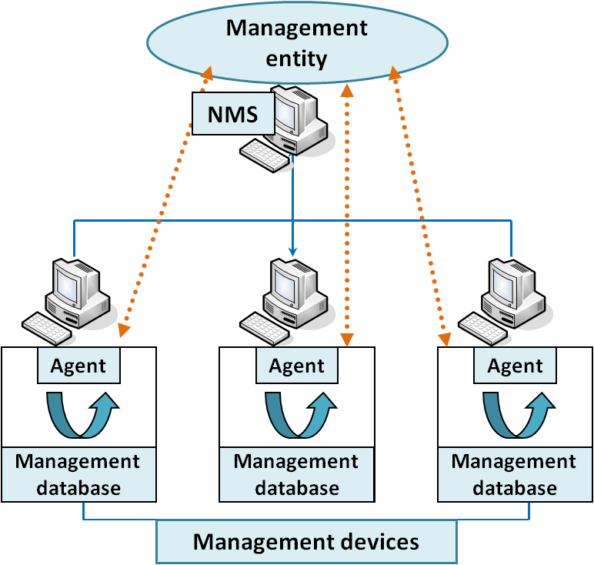
What is SNMP?
Simple Network Management Protocol
Most popular management protocol in use
Allows for simplistic trap setting and data polling
2
Notes:
First (1980) attempt to standardize the way data is organized on a network
Groups similar data in Management Information Bases which describe what each data point means and its relation to other data points
These documents are well regulated
Can configure machines to send data in use defined events, each must be configured locally through a config file

Slide 5
Pros and Cons
Pros
Very well standardized and documented
Most widely used
Accessed through command line
Flexible accessibility
Consistent data formatting
Cons
Simplistic commands make scripting hard
Data is instantaneous
Data is per device
Uses UDP
Configuration is difficult
3
Notes:
PROS
Oldest protocol around, evolved well over the years and most widely used
Newer versions have better security and more commands
Extensive documentation and
Accessed through command line and very efficient for data transfer
Can define what users have access to what data through community names
Consistent data formatting through options in the command, means that data is very easily parsed and allows the many GUIs built on it to function
CONS
Simplistic commands make for very inflexible scripting
Means that network wide changes are very difficult
Data returned is the data for that instance
Means that historical data is hard to display (mostly done through routine polls)
Data is per device
Network wide monitoring requires polling each individual device and summing
Uses UDP
Means that devices can just ignore commands
Configuration is difficult
Must be done locally for each device (can be done remotely, but then you must go through a configuration program)

Slide 6

What is CLI?
Command Line Interface
A catch all catagory for proprietary tools run from the command line
Often used for machines that cannot run a GUI
4
Notes:
Various tools (there are hundreds) used through the command line to view network data
Most people chose one to learn and stick to it
Introduced text based commands, lots of them (think different programming languages)
Mostly used for the configuration of devices since SNMP was so awful at it
Eventually got regulated by IEFT because of its widespread use

Slide 7
Pros and Cons
Pros
Text based commands are easier to read
Much larger and more flexible vocabulary
Can be scripted into programs
Devices cannot ignore commands
Cons
Data format is unpredictable
Commands are not standardized
No error management
Not version control
Little access control and security
5
Notes:
PROS
Text based commands make it much easier to learn and use, the learning curve is much better
Large and more flexible vocabulary allows for larger more complex programs
Can be scripted to use for network wide configuration and montorting
Devices cannot ignore commands
CONS
Data format is unpredicatable so programs cannot be fully automated
Commands are not standardized so each programmer may use their own tool with different results
There is no error management or guarantee to the validitiy of the data
Similarly there is no version control (think of a crazy open source mess)
No way to limit access to users or secure data

Slide 8
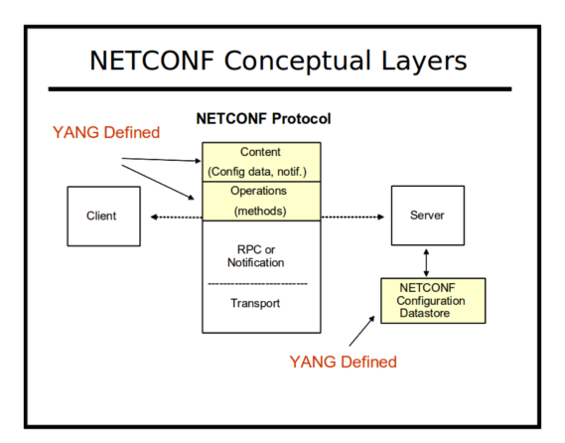
What is Netconf?
Client and sever communicate through XML files on a secure conection-oriented session
Mostly used for configuration
Aimed to mimic the native functionality of the device
Image courtesy of netconf central
6
Notes:
Replaces the passing of device data and configurations in simple strings with large XML files
Data format is described in XML DTDs or XML schemas (tell the client and server what syntax to expect
functionality of the management protocol to closely mirror the native functionality of the device

Slide 9
Pros and Cons
Pros
XML format is easy for humans and computers to read
Allows for transactions
Can handle partial configurations
Client can discover what protocols the server accepts
Can be used with XML transformation programs to automate more
Cons
XML files are very large and hard to pass
Little standardization of XML schemas
Not all devices can use it
7
Notes:
PROS
XML is a very easy language to learn, and computers can easily parse it given standardized tags
Transactions are full command sets to be executed in an arbitrary order on a network wide scale, makes programming for large complex neworks easier
Can handle partial configurations
Are common and crash SNMP and CLI
Client can be programmed to adapt to different protocols on servers to make programs less fragile
XML transformation programs make automation easier
CONS
XML files are large and hard to pass around
While schemas are used there is little standardization around what they should be

Slide 10
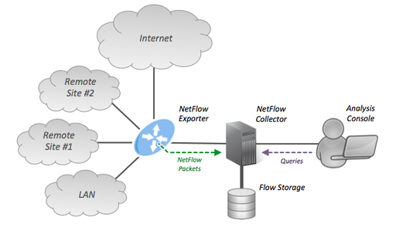
What is Netflow?
8
Notes:
Routers and switches collect IP traffic statistics on all interfaces and export those statistics as records, to a server that does the actual traffic analysis.
does this through use defined flows
unidirectional stream of packets
identified by source and destination IP addresses, IP protocol, source and destination ports, and Type of Service
Implemented on a interface by interface basis to lessen the load
created by cisco
Ipfix extends netflow to use templates, adds security, allows for sampling to lessen load
uses SNMP base

Slide 11
Pros and Cons
Pros
Very easy to use and implement
Data is consolidated in a readable report
Can take samples to lighten traffic
Cons
Little security
Not available on devices not made by cisco
Cannot custom configure devices
9
Notes:
PROS
Easy to implement, you just tell it what data to include in its report
Report consolidates data well, often ports to a GUI which makes graphs and fun stuff
This report generation is heavy, but you can set it to take data from random devices instead of all of them to lighten it
CONS
There is very little security (IPFix fixes this)
Not available on non cisco devices (IPFix is attempting to create ways to use it on all devices)
Cannot custom configure devices
Implemented on a interface by interface basis which can be irritating to set up

Slide 12
Analysis
NAME | GOOD AT | BAD AT | RECOMMENDED USES
SNMP | Efficiently montitoring devices on a network for specific data | Monitoring entire networks for all data | As a basis for more complex GUIs
CLI | Scripts of large complexity | Parsing retreieved data | Configuring large networks
NETCONF | Easily configuring a network | Gathering large amounts of data | Configuring large networks
NETFLOW | Gathering large amounts of data | Protability | Network monitoring for networks made supported devices
10
Notes:
SNMP: good for polling efficient and can gain a lot of data, but difficult to use and data is scattered, good to build GIU's for
CLI: more readable syntax for humans, not standardized and tonnes of different ones, good for advanced network admins who want to check on network wide things, use if Netconf isnt avaliable
Netconf: very easy to configure on a network, but gets super bogged down with large xml files, good for configuring devices on a network
Netflow: good at gathering easy to read data, not always available, good for collecting performance data

Slide 13
Resources
Linglaw, David. “What is Netconf?” Tail-f. 30 May. 2014
<http://www.tail-f.com/education/what-is-netconf/>
Uttam, Kumar. “IPFIX and Netflow.” StartNetworks. 30 May. 2014
<http://www.startnetworks.info/2011/05/ipfix-and-netflow.html>
Schoenwaelder, J. “RFC3535: Overview of the 2002 IAB Network Management Workshop.” Network Working Group. May 2003.
Claise, B. “RFC5101: Specification of the IP Flow Information Export (IPFIX) Protocol for the Exchange of IP Traffic Flow Information.” Network Working Group. January 2008.
Stapp, M. Lemon, T. Gustafsson A. “RFC4701: A DNS Resource Record (RR) for Encoding Dynamic Host Configuration Protocol (DHCP) Information (DHCID RR).” Network Working Group. October 2006.
11

